Slide 1
Applications of Data structures using Java
By – Aakash Kumar Nanda

Slide 2
What are Data Structures
The data structure is not any programming language like C, C++, java, etc. It is a set of algorithms that we can use in any programming language to structure the data in the memory.
You apply a data structure using a programming language

Slide 3
Examples of Data Structures
Array
Stack
Queue
List
Map
Tree
Graph
Set

Slide 4
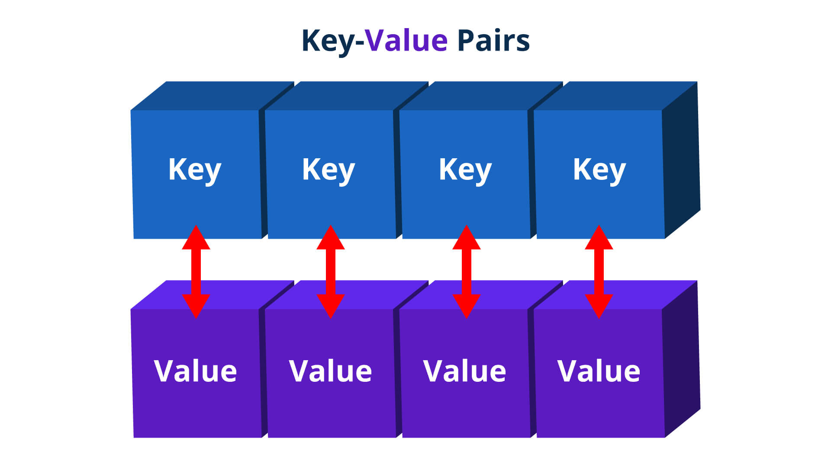
Map

Slide 5

Time for some hands one experience
Lets get some hands on experience of the concept

Slide 6
HashSet
HashSet stores the elements by using a mechanism called hashing.
HashSet contains unique elements only.
HashSet allows null value.
HashSet doesn't maintain the insertion order. Here, elements are inserted on the basis of their hashcode.

Slide 7
Time for some hands one experience
Lets get some hands on experience of the concept

Slide 8
Thank You!!

